Slide 1
Database System Concepts
and Architecture

Slide 2


Three Schema Architecture
Data Independence
Database Languages
2

Slide 3

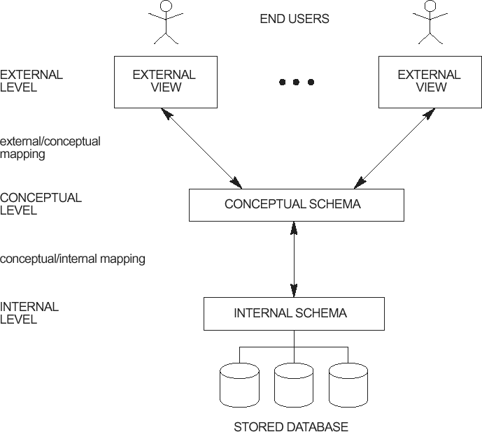
Three-schema architecture
The goal of the three-schema architecture is to separate the user applications from the physical database.

Slide 4
Three-Schema Architecture
Internal Schema
The internal level has an internal schema
Describes the physical storage structure of the database.
The internal schema uses a physical data model
describes the complete details of data storage and access paths for the database.
4

Slide 5
Three-Schema Architecture
Conceptual schema
The conceptual level has a conceptual schema
Describes the structure of the whole database for a community of users.
The conceptual schema hides the details of
physical storage structures
concentrates on describing
entities,
data types, relationships, user operations, and constraints.
Usually, a representational data model is used to describe the conceptual schema
5

Slide 6
Three-Schema Architecture
External schema
The external level includes a number of external schemas
Each external schema describes the part of the database that a particular user group is interested in and hides the rest of the database from that user group.
Each external schema is typically implemented using a
representational data model.
6

Slide 7
Three-Schema Architecture
The three schemas are only descriptions of data; the actual data is stored at the physical level only.
In the three-schema architecture, each user group refers to its own external schema.
The DBMS must transform
a request specified on an external schema into a request against the conceptual schema, and then into a request on the internal schema for processing over the stored database.
If the request is a database retrieval, the data extracted from the stored database must be reformatted to match the user’s external view.
7

Slide 8
Three-Schema Architecture
The processes of transforming requests and results between levels are called mappings.
These mappings may be time-consuming,
so some DBMSs—especially those that are meant to support small databases—do not support external views.
Even in such systems,
it is necessary to transform requests between the conceptual and internal levels.
8

Slide 9
Data Independence

Slide 10
Data Independence
The three-schema architecture can be used to further explain the concept of data independence
Defined as the capacity to change the schema at one level of a database system without having to change the schema at the next higher level.
Two types of data independence:
Logical Data Independence
Physical Data Independence
10

Slide 11
Logical Data Independence:
The capacity to change the conceptual schema without having to change the external schemas and their application programs.
Change the conceptual schema to
Expand the database (by adding a record type or data item),
change constraints
Reduce the database (by removing a record type or data item).
External schemas that refer only to the remaining data should not be affected.
Only the view definition and the mappings need to be changed in a DBMS that supports logical data independence.
After the conceptual schema undergoes a logical reorganization,
application programs that reference the external schema
11
constructs must work as before.

Slide 12
Three-schema architecture

Slide 13
Physical Data Independence:
The capacity to change the internal schema without having to change the conceptual schema.
The external schemas need not be changed as well.
Changes to the internal schema may be needed because some physical files were reorganized—for example, by creating additional access structures—to improve the performance of retrieval or update.
If the same data as before remains in the database, we should not have to change the conceptual schema.
The query would be executed more efficiently by the DBMS by utilizing the new access path.

Slide 14
DBMS
Languages

Slide 15
Data Definition language (DDL)
DBMS supports a variety of users.
The DBMS must provide appropriate languages and interfaces for each category of users.
We explore the types of languages and interfaces provided by a DBMS.
Once the design of a database is completed and a DBMS
is chosen to implement the database
The first step is to specify conceptual and internal schemas for the database and any mappings between the two.

Slide 16
Data Definition language (DDL)
In many DBMSs where no strict separation of levels is maintained,
one language, called the data definition language (DDL), is used by the DBA and by database designers to define both schemas.
The DBMS will have a
DDL compiler
whose function is to process DDL statements
in order to identify descriptions of the schema constructs and
to store the schema description in the DBMS catalog.

Slide 17
Storage definition language (SDL)
In DBMSs where a clear separation is maintained between the conceptual and internal levels
The DDL is used to specify the conceptual schema only.
Another language, the storage definition language (SDL), is used to specify the internal schema.
The mappings between the two schemas may be specified in either one of these languages.

Slide 18
View Definition Language (VDL)
For a true three-schema architecture,
Need a third language, the view definition language (VDL)
To specify user views and their mappings to the conceptual
schema
In most DBMSs
The DDL is used to define both conceptual and external schemas.
In relational DBMSs,
SQL is used in the role of VDL
To define user or application views as results of predefined queries

Slide 19
Data manipulation language (DML)
Once the database schemas are compiled
The database is populated with data
Users must have some means to manipulate the database.
Typical manipulations include retrieval, insertion, deletion, and modification of the data.
The DBMS provides a set of operations or a language called the data manipulation language (DML) for these purposes.

Slide 20
Data manipulation language (DML)
In current DBMSs,
a comprehensive integrated language is used that includes constructs for conceptual schema definition, view definition, and data manipulation.
Storage definition is typically kept separate
It is used for defining physical storage structures to fine-tune the performance of the database system
which is usually done by the DBA staff.
A typical example of a comprehensive database language is the SQL
which represents
a combination of DDL, VDL, and DML,
as well as statements for constraint specification,
schema evolution, and many other features.

Slide 21
Data manipulation language (DML)
There are two main types of DMLs.
A high-level or nonprocedural DML
can be used on its own to specify complex database operations concisely.
Many DBMSs allow
high-level DML statements either to be entered
interactively from a display monitor or terminal or to be embedded in a general-purpose programming language.
In the latter case,
DML statements must be identified within the program
so that they can be extracted by a precompiler and processed by the DBMS.

Slide 22
Data manipulation language (DML)
A lowlevel or procedural DML must be embedded in a general-purpose programming language.
This type of DML typically retrieves individual records or objects from the database and processes each separately.
Therefore,
it needs to use programming language constructs
such as looping
to retrieve and process each record from a set of records.

Slide 23
Data manipulation language (DML)
Low-level DMLs are also called record-at-a-time because of this property.
DMLs
High-level DMLs,
such as SQL
can specify and retrieve many records in a single DML statement;
therefore, they are called set-at-a-time or set-oriented DMLs.
A query in a high-level DML often specifies which data to retrieve rather than how to retrieve it; therefore, such languages are also called declarative.

Slide 24
Data manipulation language (DML)
Whenever DML commands, whether high level or low level
are embedded in a general-purpose programming language, that language is called the host language and the DML is called the data sublanguage.
On the other hand, a high-level DML used in a standalone interactive manner is called a query language.

Slide 25

Three Schema Architecture
Data Independence
Physical
Logical
Database Languages
DDL
VDL
SDL
DML

Slide 26


